Slide 1

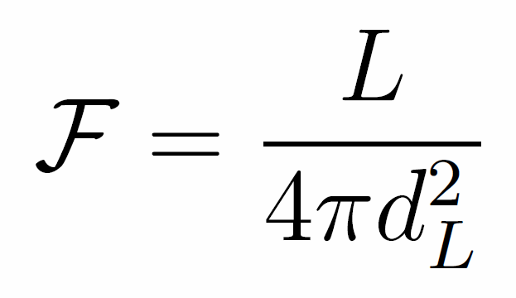
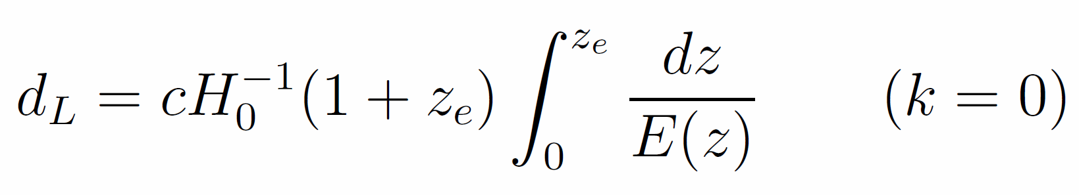
Cosmological Distances
Co-moving Distance
Luminosity Distance
Magnitude Conversion
Notes:
dH (hubble distance) radius of the visible universe. Luminosity distance is redshifted. Magnitude conversion is for AB system. Get volume from comoving volume.

Slide 2

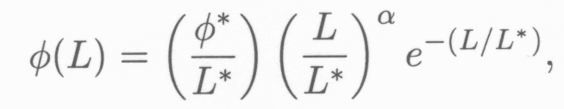

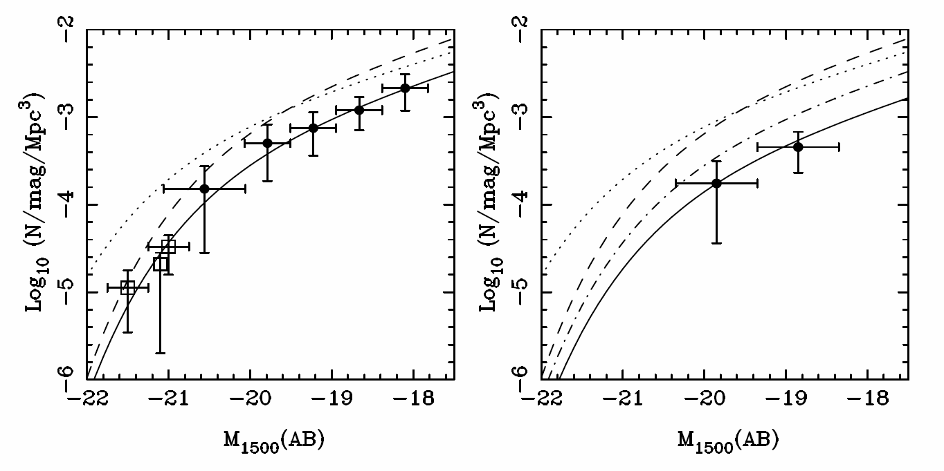
Schechter Function
Z=7
Z=8
(McLure, 2010)

Slide 3


Schechter Function
Number Density:
Luminosity Density:

Slide 4
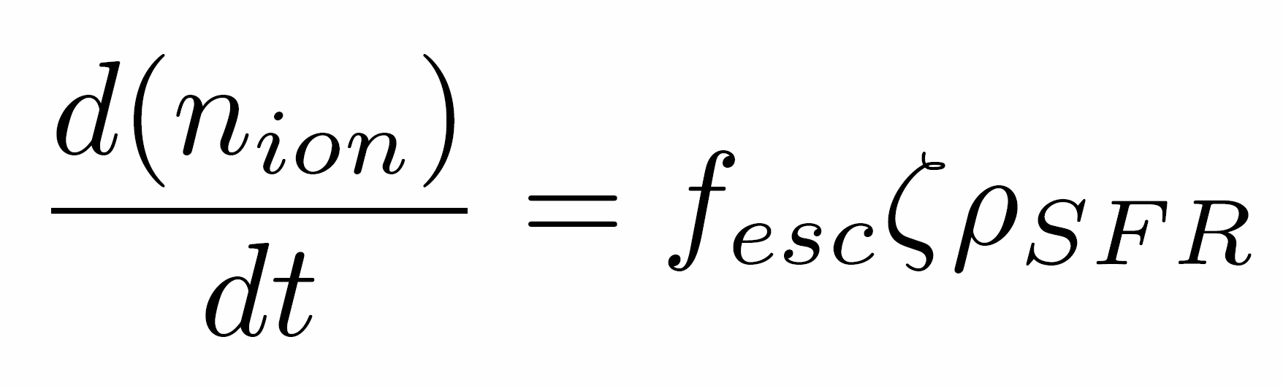
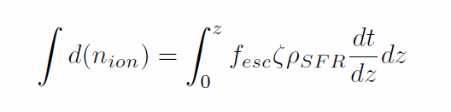


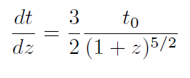
Star Formation Rate
(Kennicutt 1998)
Where assuming matter dominated epoch,

